Slide 1

Third stage of labor
Dr parichehr pooransari perinatalogist

Slide 2
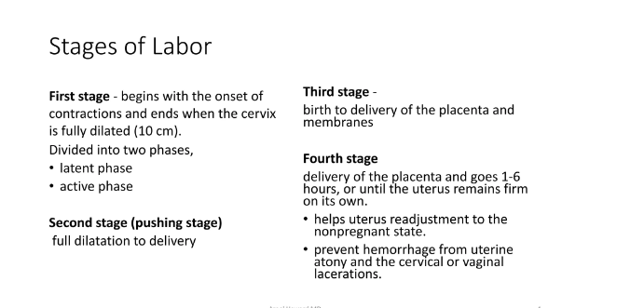

Slide 3
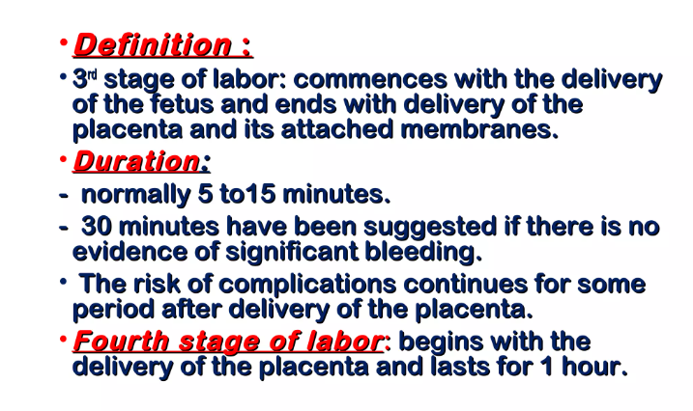

Slide 4
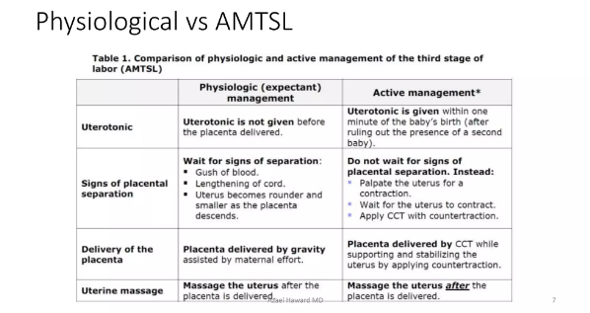

Slide 5
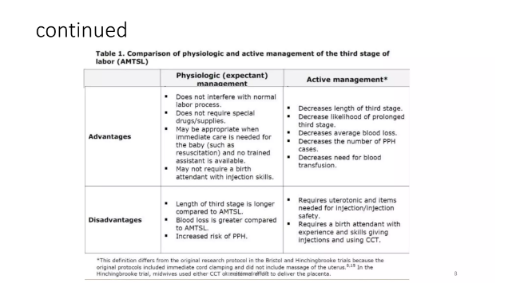

Slide 6
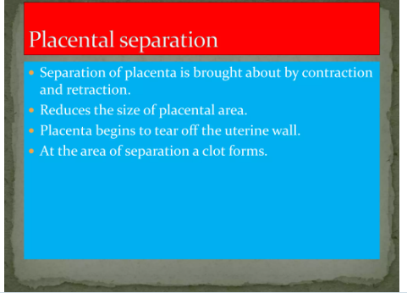

Slide 7
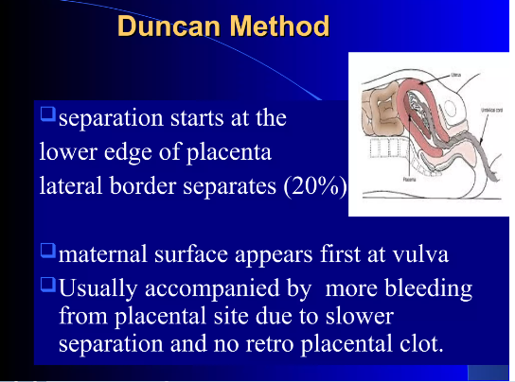

Slide 8
ASSESSMENT OF THE PLACENTA
Infractions that are recent(bright red) or old(gray patches)
Localised calcification(flattened white plaques)
Lobes
Blood vessels
Insertion of the cord
Umbilical vessels
Cord length
Weight of the placenta

Slide 9
Placental seperation and descent occur spontaneously
Mothers efforts are used to aid expulsion
Minimal assistance is given if mothers effort fails to deliver the placenta

Slide 10
ASSISTED EXPULSION
CONTROLLED CORD TRACTION (MODIFIED BRANDT – ANDREWS METHOD)
Several checks to be made before proceeding
An oxytocic drug has been administeredIt has been given time to actThe uterus is well contractedCounter traction is appliedThe signs of placental seperation and descend are present

Slide 11
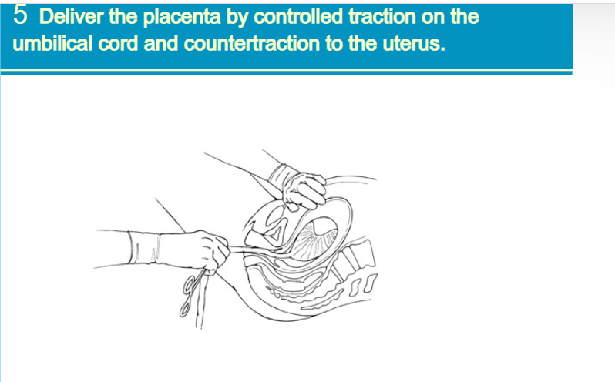

Slide 12
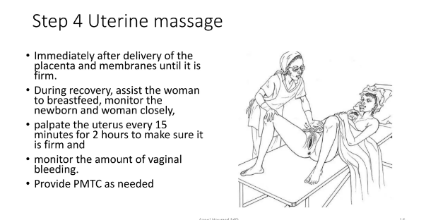

Slide 13
COMPLETION OF THE THIRD STAGE
Ensure that uterus is well contracted
Fresh blood loss is minimal
Inspection of the perineum and the lower vagina
Suture the episiotomy or any slight laceration
Change all the soiled linen
Cleanse the perineum
Application of sterile pad
Examination of the placenta membrane

Slide 14
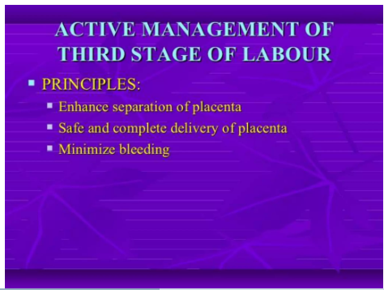

Slide 15
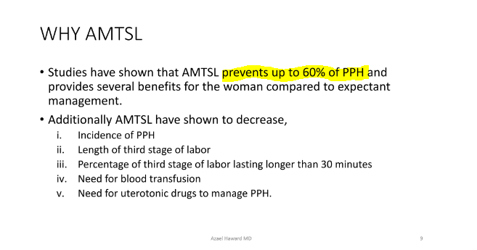

Slide 16
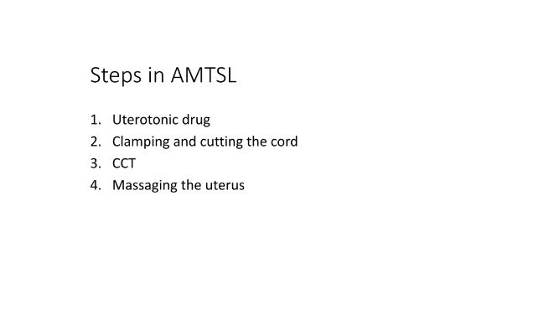

Slide 17

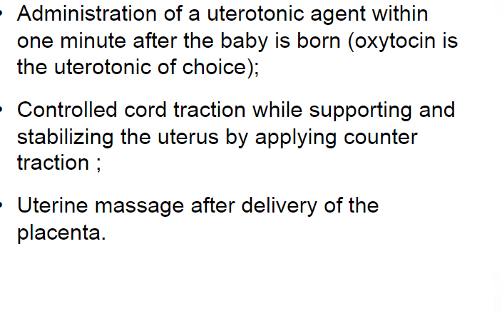

Slide 18
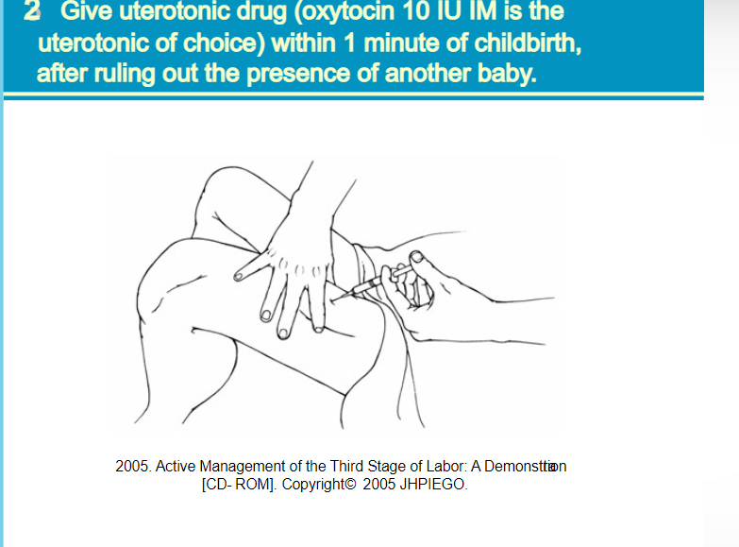

Slide 19
Third stage Most crucial Life threatening complications
PPH(postpartum haemorrhage)
Retained placenta
Inversion of uterus
Pulmonary embolism

Slide 20
Prophylaxis of PPH Improvement of
health status of mother(Hb>11gm%)
Identify high risk women
Plan for institutional delivery /SBA
Strict vigilance of all women in 3rd stage labor
Practice AMTSL in all
Examination of afterbirths ,should be a routine
Explore Uterovaginal canal following difficult/ instrumental, destructive delivery

Slide 21
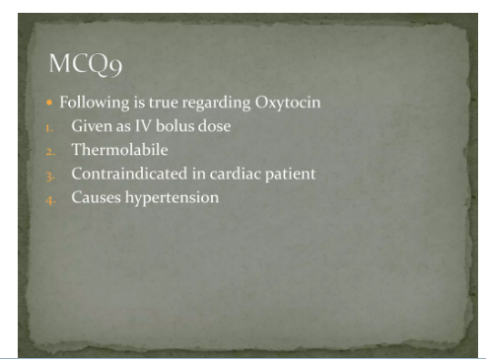

Slide 22
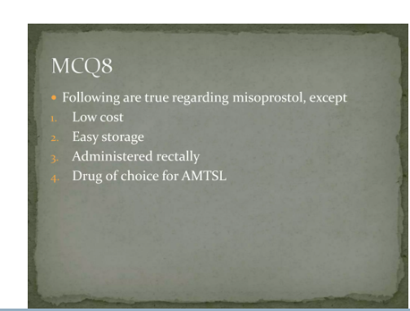

Slide 23
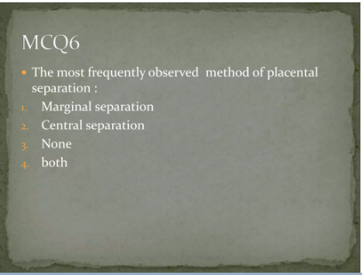

Slide 24
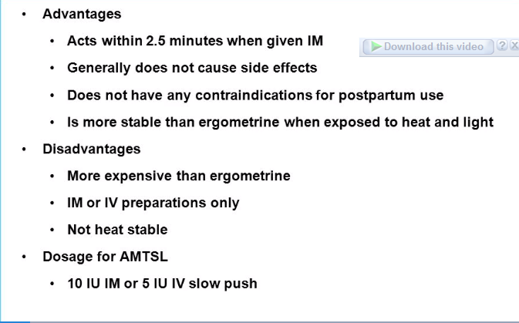
oxytocin

Slide 25
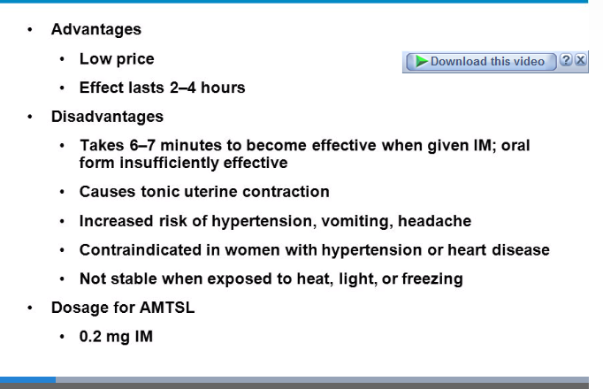
metergin

Slide 26
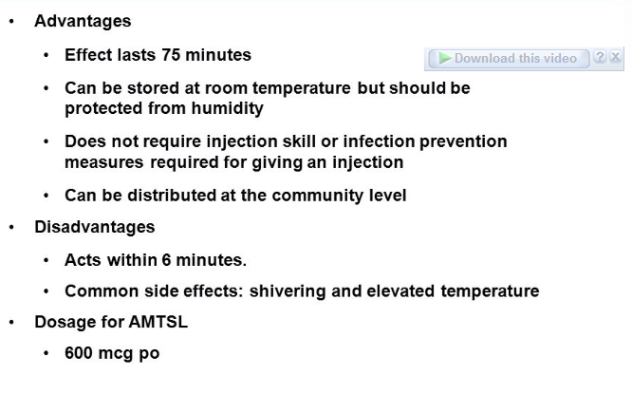
misoprostol

Slide 27
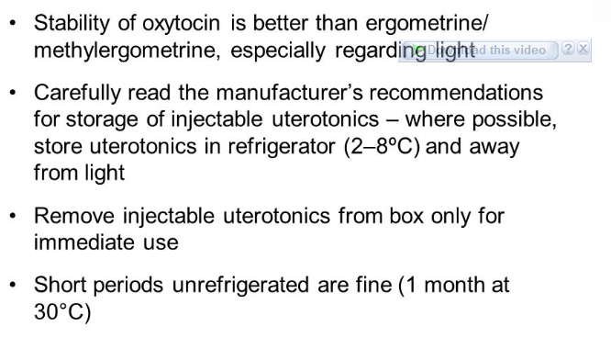
summary

Slide 28
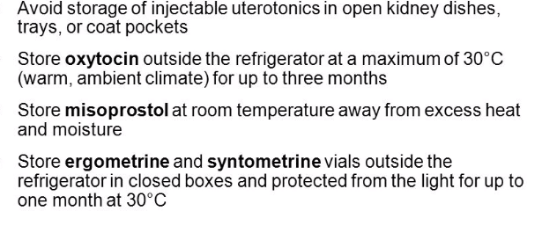

Slide 29

This Photo by Unknown Author is licensed under CC BY-SA

